Slide 1
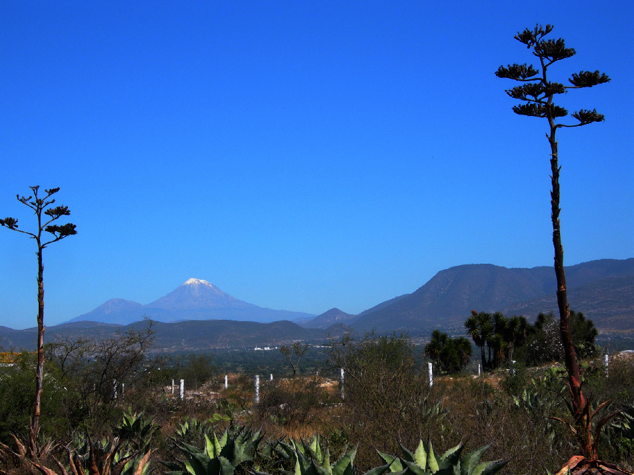

RAD sequencing, genotyping error estimation and de novo assembly optimization for population genomics and phylogeography
Alicia Mastretta-Yanes
amastretta@conabio.gob.mx
AliciaMstt
Notes:
Hello, my name is Alicia, I’m a PhD student at the University of East Anglia
The broad focus of my PhD is on phylogeography of plants, which in this background picture
you guessed wrong, not these ones but the ones growing at the top of mountains like the ones in the behind
However for this talk I won’t focus on my study species, not even on plants, but in some methodological considerations that I realized when venturing into using RADsequencing,
which are the importance of estimating genotyping errors and optimazing de novo assembly
This is important for anyone using RADseq in any spp

Slide 2
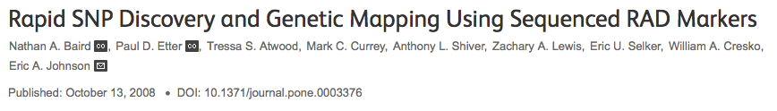
Restriction site-associated DNA sequencing
Proportion of the genome sequenced
Sanger sequencing
Whole genome
sequencing
Reduced representation genome sequencing
non model species revolution
Notes:
Restriction site-associated DNA sequencing (RADseq) first coined by Baird et al. and that has developed into a family of related approaches.
so called
Reduced representation genome sequencing
methods that allow to subsample a genome at homolous locations to identify and type hundreds of thousands of SNPs
This provides many times more loci than what is achievable with Sanger sequencing, is much more less expensive than whole genome resequencing
This has the potential of revolutionizing molecular ecology and evolutionary studies as it can be applied can be applied to non model species because no previous genome knowldedge is necessary

Slide 3
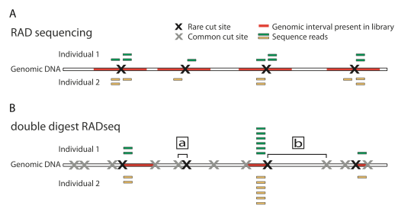
“RAD-locus”
Coverage
Peterson et al. 2012. PLoS ONE
Notes:
In brief, RAD sequencing consists on digesting a genome with a restriction enzime and using a NGS platform such as Illumina to sequence the fragments
A variant is the double digest RAD sequencing, in which the genome is sequenced with 2 enzimes: a rare and a common cutter so only the bits within a certain distance are sequenced. This allows to subsample fewer loci and to increase the number of individuals to be sequenced in the same lane.
A quick word in terminology, this is what I will be refering at as RAD-locus, that can have different alleles and present SNPs.
Coverage is how many reads of that same loci are obtained during the sequencing, which is important to be sure that a given SNP is real and not a sequencing mistake.

Slide 4
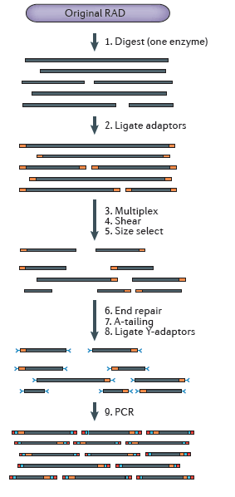
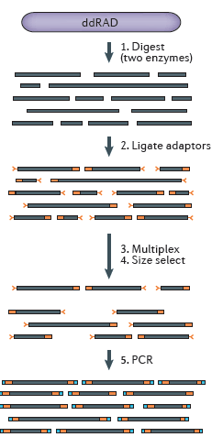
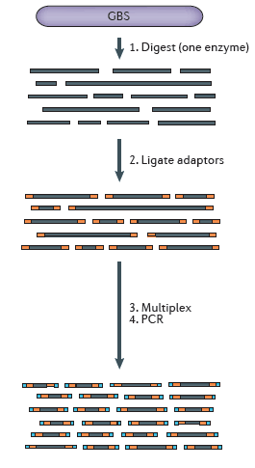

Slide 5
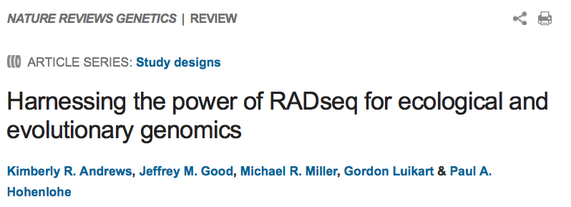
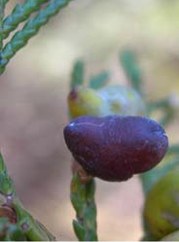
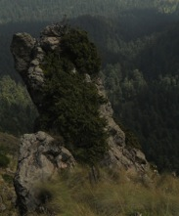
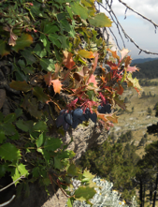
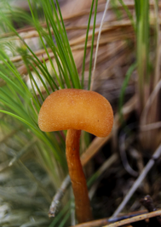
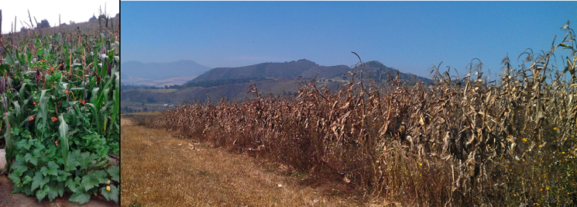

Slide 6
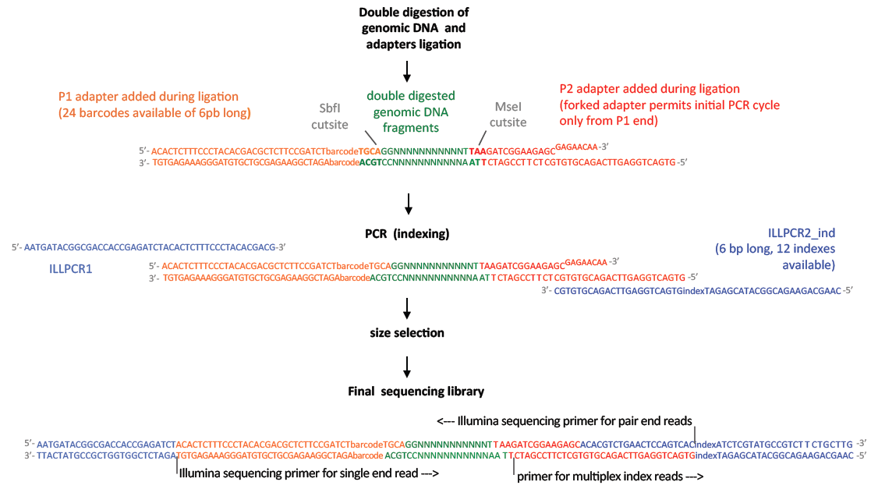

Slide 7
Implications of genotyping errors for population genetics
Artificial excess of homozygotes
False departure from Hardy–Weinberg
Overestimation of inbreeding
Unreliable inferences about population structure
Wrong estimations of nucleotide diversity
Incorrect inferences at the genome-wide level
mitigated and accounted for if error rates are
quantified and reported
overlooked in RADseq
Notes:
RAD seq is revolutionizing the amount of data we can get for non model species, however as all molecular markers, is still suffers from genotyping errors.
which are important for population genetics and phylogeography because they can cause
artificial excess of homozygotes (Taberlet et al. 1996), false departure from Hardy–Weinberg equilibrium (Xu et al. 2002), overestimation of inbreeding (Gomes et al. 1999), unreliable inferences about population structure (Miller et al. 2002), wrong estimations of nucleotide diversity and incorrect inferences at the genome-wide level (Pool et al. 2010).
among other nigthmares
The good news is that all potentially inaccurate inferences can be mitigated and accounted for if error rates are quantified and reported
I decided to include this information for my data however this has been largely overlooked by most recent RAD studies

Slide 8
RADseq sources of error
Technical & human
Species genome
Wet lab
PCR stochastic sampling events
Bioinformatics
Assembly algorithm
Mismatches parameters
Next Generation Sequencing
Notes:
RADseq is prone to both technical and human sources of error, similar to some that have been identified for other molecular markers
But also there are others sources of error more specific to RADseq that arise during the Wet lab, parallel sequencing, that are related to the properties of the species genome or that may arise during the bioinformatics stage .
I’m not going to touch each one in detail, but for example
stochastic sampling events taking place during the PCR steps may affect amplification success, such that depth of coverage may vary among loci and individuals, potentially causing locus or allele dropouts
and on the bioinformatic stage
when RAD sequences are assembled into loci and alleles, often using distance-based criteria, genotyping results will vary according to algorithm used, how variation in coverage is handled and which mismatches parameters where used.

Slide 9
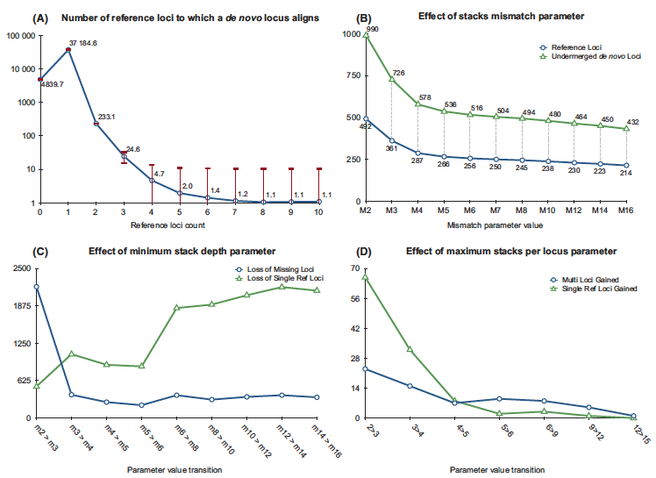
Stacks (Catchen et al. 2011, 2013)
-m minimum number of identical raw reads required to form a stack
-M mismatches allowed between stacks when processing an individual
-max_locus_stacks maximum stacks allowed per locus
-n number of mismatches allowed between loci when building the catalog
sets of short-read sequences that match (“stacks”)
genotyped loci per individual
Number of loci
Number of loci
output depends on parameters values
Catchen et al 2013 Mol. Ecol.
Notes:
For example, the program Stacks, that is one widely used assembly and genotyping tool for RAD data uses these parametes
to form sets of short-read sequences that match (i.e. stacks) and then to curate and assemble them into genotyped loci per individual
expalin them:
-m minimum number of identical raw reads required to form a stack,
-M mismatches allowed between stacks when processing an individual
-max_locus_stacks maximum stacks per locus pa
-n number of mismatches allowed between loci when building the catalog
Catchen et al. (2013) explored how variation in the first three parameters affects the recovery of real RAD loci
They ran the de novo pipeline using different parameter values and compared the results to the expected loci based on a reference genome.
In short, for they data they found that increasing -M you get loci more closer to what are the real loci according to the reference genome
C) Regarding small –m the higher it gets the more true loci (green line) that are lost, but at small values the more false loci that kept (blue line)
And finally, (D) as the number of stacks allowed to exist at a single locus increases there is a trade-off between the number of true loci added to the data set (green line) vs. the number of false loci we add to the data set (blue line).

Slide 10
Optimal parameter values depend on:
Polymorphism of the genome
Sequencing error
Depth of sequencing
Explore values for each data set
No reference genome?
DNA replicates
- expectation of genome identity
De novo assembly algorithms
Estimate error rates
Notes:
The authors concluded that the optimal values for Stacks parameters will depend upon the polymorphism of the genome being analysed, the amount of sequencing error and the depth of sequencing performed.
Therefore they recommend to explore a range of parameter values in order to optimize the analysis of each RADseq dataset.
This strategy is however only possible if a reference genome is available, so what to do if you don’t have one, which is the case of the kind of species we want to apply RAD seq to
So what I’m going to present in this talk is an example of how to use DNA replicates, that is samples with the same DNA source but barcoded and treated independently during the whole protocol, to optimize de novo assembly parameter values.
We focused on Stacks here, but the same principle could be used in the assembly tool of your choice.
And, very important, the DNA replicates allow to estimate genotyping error rates, another point that I will touch during this talk

Slide 11

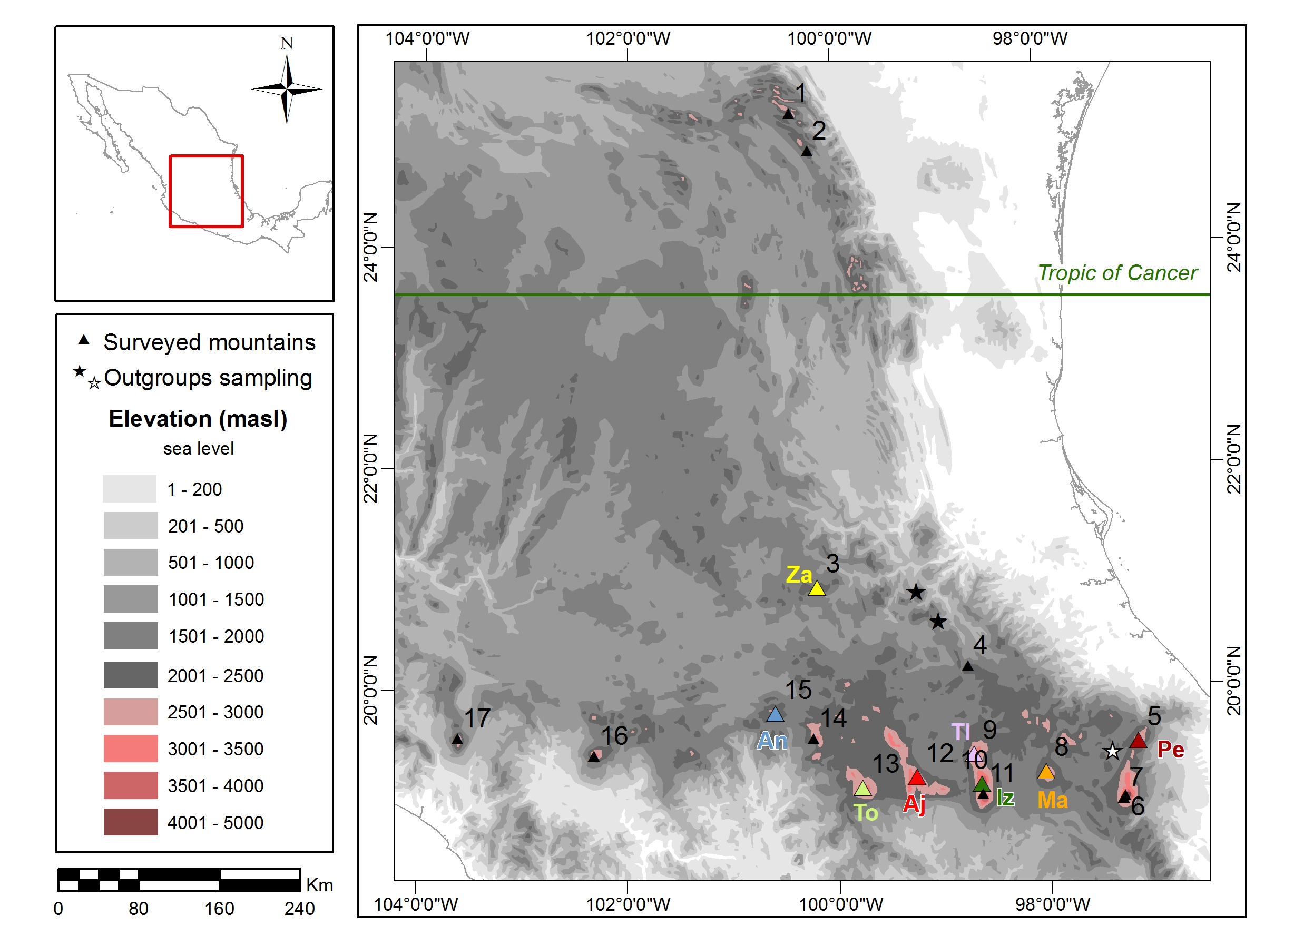
Berberis alpina
ddRAD (EcoRI and MseI)
3 sequencing lanes
27 samples + 5 replicates
Populations and taxonomy represented
Genome: ~1.5 Gb, diploid
Notes:
Now I would like to give a little bit of background on the species I will use as an empirical example.
For my PhD I’m performing a comparative phylogeographic analysis of plants that grow only on the highest mountains of the Transmexican Volcanic Belt, in Mexico.
Berberis alpina has the most restricted range of them all. It grows only in these 8 mountains out of the 17 of the study area
This is a very interesting study system, but as with many plants, it was not possible to get enough variation for phylogeography using traditional markers. But thankfully RAD seq came to the rescue.
As for previous genome knowledge, it is a typical example of a non model species, we only know that it has a genome of ~1.5 Gb genome and that it is diploid.
So we decided to build a ddRAD library using EcoRI and MseI
As for the experimental design we divided our samples in three libraries to be sequenced in an independent lane.
Each library was comprised of 27 Berberis sp. with 5 replicates chosen at random but representing all populations and outgroups
And samples well positions were randomized during labwork

Slide 12
Exploratory analysis of Stacks key parameters using replicates
Assembly parameters
-m: 2 to 15
-M: 2 to 10
-n: 0 to 5
-max_locus_stacks: 2 to 6
SNP calling model: free vs upper bound of 0.5, 0.25, 0.15, 0.1, 0.05 and 0.0056
Evaluate
Number of loci and SNPs
Error rates
Distribution of missing data
11 replicate pairs
-m min. raw reads to form a stack (“minimal coverage”)
-M mismatches between stacks when processing an individual
-max_locus maximum stacks allowed per locus
-n mismatches between loci when building the catalog
Notes:
Then, at the bioinformatic stage, what we did was to run the assembly pipeline of Stacks with these different combinations of parameter values
using the 11 replicate pairs that sequenced successfully
And we evaluated the number of loci and SNPs, the distribution of missing data and the error rate between replicate pairs.

Slide 13
Error rates
Number of RAD-loci present in only one of the samples of a replicate pair
Total number of RAD-loci
Locus error rate =
Number of allele mismatches between
a replicate pair
Number of alleles for the replicate pair
Allele error rate =
SNP mismatches between
a replicate pair
Number of SNPs for the
replicate pair
SNP error rate =
Notes:
allele =/= SNPs more SNP in one allele

Slide 14
Results
Output loci and SNPs
Number of RAD-loci
Number of SNPs
The information content of RADseq data varies greatly depending on the assembly parameters, especially min. coverage
Which are the best loci to keep?
-m min. raw reads to form a stack (“minimal coverage”)
-M mismatches between stacks when processing an individual
-max_locus maximum stacks allowed per locus
-n mismatches between loci when building the catalog
Notes:
Lets start the results with the information content. how many loci and snps do we get using different assembly parameter values
Across all the explored parameter profiles, the number of loci recovered ranged from ~200 to >5,000 (Fig. 2a), the number of SNPs ranged from ~200 to >10,000
As you can see, the higher the min. coverage is set which is the value –m here, the less loci that are recovered.
This was expected, but such a drastic drop indicates that this Berberis dataset was particularly low in coverage and therefore that high levels of missing data can be expected
The other parameter that shows more variation is the maximum number of mismatches allowed between loci when building the catalog.
I would talk about this parameter more in a moment, but for now the main take home message is that info content…

Slide 15
Results
Allele and SNP error rates
!!!
2-10
M
2-15
m
0-5
n
2-6
mxloc
2-10
M
2-15
m
0-5
n
2-6
mxloc
RADseq data has error, and it can be very high
You won’t know it without replicates
Error can be decreased by tuning the assembly parameter values
-m min. raw reads to form a stack (“minimal coverage”)
-M mismatches between stacks when processing an individual
-mxloc maximum stacks allowed per locus
-n mismatches between loci when building the catalog
Notes:
The number of RADloci and SNP varies. All right, but what is the best thing to do? Having more loci or fewer at a higher coverage? And does size matter? (but wait, that an un related question).
Well I think here it is the allele and SNP error rates
Regarding the allele and SNP error rates, we found levels that could reach more than 15 and 10% percent,
which is quite alarming and highlights why it is important to have this information for RADseq studies.
However, the good new is that as you can see, the error can be decreased considerably by tuning certain parameter values.
In particular, for each data set the number of mismatches between loci when building the catalog reduced the error considerably.
When n>0, Stacks attempts to merge alleles into a single locus based on their consensus sequence.
This is particularly important for the Berberis data set because samples come from geographically isolated populations and outgroups, conditions that would be expected to result in loci that exhibit fixed differences among populations
By merging fixed alleles into a single locus the allele error rate decreased, probably because the chances of assembling the same true alleles in both replicates increased.
But also notice how increasing the minimum coverage does not decrease the allele and SNP error rate

Slide 16
Results
Distribution of missing data
Proportion of loci missing
RADseq produces missing loci that are randomly distributed and little affected by assembly parameters
Missing loci could be handled as missing data, but erroneous alleles and SNPs have negative consequences on biological inferences
2-10
M
2-15
m
2-6
mxloc
0-5
n
Proportion of missing loci different within a replicate pair
Locus error rate
2-10
M
2-15
m
2-6
mxloc
0-5
n
2-10
M
2-15
m
2-6
mxloc
0-5
n
-m min. raw reads to form a stack (“minimal coverage”)
-M mismatches between stacks when processing an individual
-mxloc maximum stacks allowed per locus
-n mismatches between loci when building the catalog
Notes:
Now, Regarding the distribution of missing data
The total number of missing loci is sensitive to changes in –min coverage
but it remains around 10% if they are considered as a proportion of the total loci recovered, with no difference among the parameter values tested.
C) A key source of variation between replicate pairs is that the distribution of missing data is stochastic, as shown by the fact that most of the missing loci of a given sample are not the same lost in its replicate
This suggests that stochastic PCR and sequencing sampling events are causing heterogeneous coverage among loci
D) which leads to quite high locus error rates, of more than 10%. Where the only way to slightly decrease it is to increase the value of the min coverage parameter
However,
Missing loci can be handled to some extent as missing data, but erroneous SNP and alleles, as shown in the previous diapositive, can affect more biological inferences, so maybe it is best to keep relatively high levels of missing data and therefore locus error rate, but with a lower allele and snp error rate

Slide 17
Results
“Best” parameter values
Highest number loci & SNP
Lowest allele & SNP error rate
m= 3, M=2, N=4, n=3, max_locus_stacks=3 and a SNP calling model with an upper bound of 0.05
Specific for this data set
Does it matter?
Notes:
Then we chose the best parameter values as the ones that generated the highest amount of loci and SNPs at the lower allele and SNPs error rates
Which were this:
I would like to highlight that this is no universal recipe but what worked best for this dataset, ie for t
So then the obvious question is, Does it matter to use these or other parameter values for population genomics and phylogeographic inference?

Slide 18
Effect on output information content and on detection of genetic structuring
Profiles
default
optimal (best from replicates analysis and m=3)
near optimal (best from replicates analysis and m=4 )
high coverage (best from replicates analysis and m=10)
Samples
B. alpina populations (75)
Closest outgroup (B. trifolia) (3)
Replicate pairs (10)
Notes:
To address that we decided to examine the effect of processing the full dataset with different parameters on the information output and the detection of genetic structuring
This time evaluating 4 different profiles of Stacks settings
the first is just the default settings
then what we call optimal and are the best values found in the replicates analysis
near optimal, which is the second best, with the only difference of increasing –m to 4
and a high coverege one, were –m was set to 10
Each parameter profile was used to run Stacks with all samples of B. alpina (75), the samples from closest outgroup (B. trifolia) and the replicate pair

Slide 19
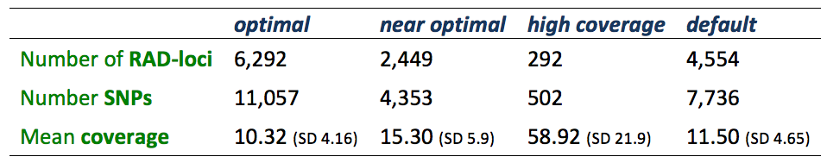
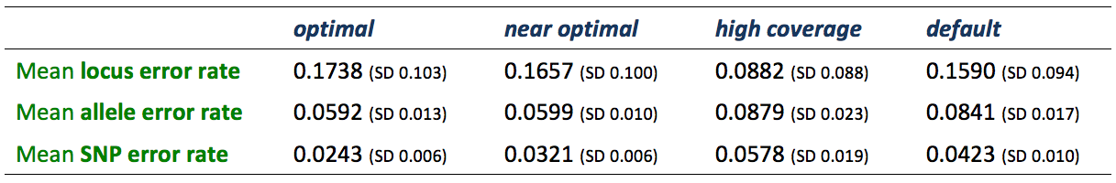
Results
Information content
Using replicates to optimize de novo assembly provides the highest information content
at the lowest allele and SNP error rates
Does optimizing for small error rates estimated from replicates improve the data quality of the rest of the samples?
Error rates
Notes:
As expected the optimal profile gave the highest number of RAD loci and SNPs at the lowest allele error rate (around 6%) and SNP error rate (around 2.4%), whilst the others were higher, specially the high coverage and default profiles
I would like to highlight that the high coverage profile. which may be the intuitive thing to chose, produced very little loci and had the highest allele and SNP error rates
Does small error rates improve the data quality of the rest of the samples?

Slide 20
Results
Genetic distance between individuals of the same locality
Optimizing de novo assembly parameters values with replicates provides uniform improvement across all samples
Notes:
So are this SNP error rates differences meaningful?
From a drift-mutation-migration equilibrium perspective, individuals sampled from the same geographic region should be expected to be genetically more similar in datasets with smaller SNP error rates.
As a simple way to test this, we compared the genetic distances between individuals of the same sampling locality among the four profiles.
As expected, the data with the smallest SNP error rate (optimal profile here in purple) systematically produced shorter genetic distances between individuals of the same sampling locality, if compared to the other three parameter profiles, specially to the default and the high coverage.

Slide 21
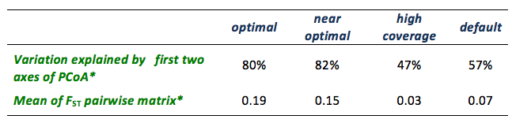
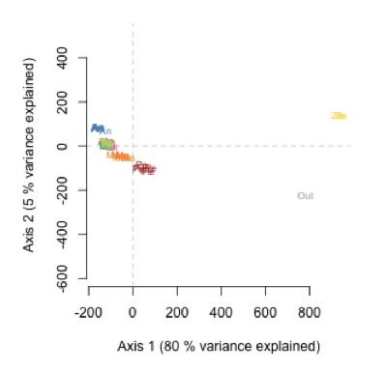
Results
Detection of structuring of genetic variation
Notes:
What this means for phylogeogrpahy is a better detection of structuring of genetic variation
The first row shows the percentage of variation explained by the first two axes of a Principal Coordinate Analyses and the second the mean of an FST pairwise matrix.
The numbers between parenthesis represent the same analyses excluding the Zamorano population
Which is this yellow population in the map
The reason why we excluded it, is because it turned out to be an interesting case of cryptic diversity, as it explains as much of the variation as the outgroup does.
Removing El Zamorano still yields substantial geographical structuring of genetic variation, because as you can see the samples cluster by geographic origin
And the F_{ST} values and the percentage of variation explained by the geographic clustering of the PCoAs remain the highest when using the data from the optimal profile

Slide 22
Conclusions and recommendations
Locus, allele and SNP error rates can be quantified with DNA replicates
Information content and error rates can be simultaneously optimized
Biological inferences should be discussed in the context of error rates
Error rates should be reported
Full power of RADseq
Notes:
Meaningful biological interpretation
As analytical tools further develop, error rates may potentially be incorporated into the data analysis itself, for instance using Bayesian hierarchical models
But for this to be possible, DNA replicates should be included in the RADseq library design
analytical tools

Slide 23
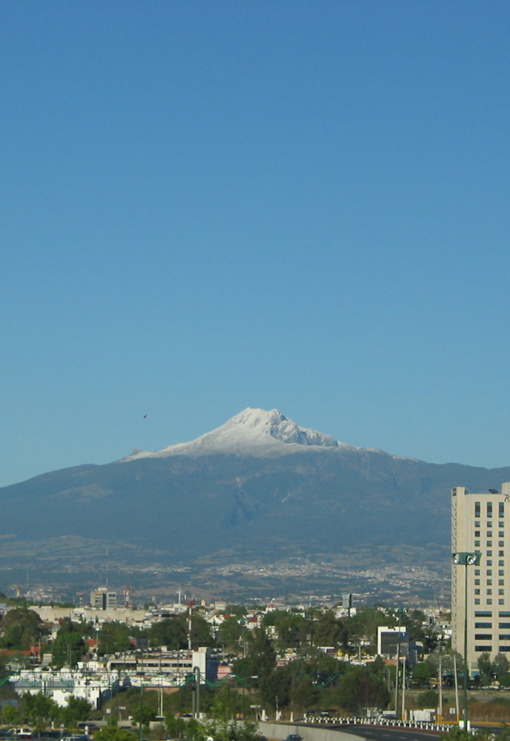







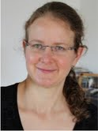


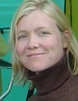
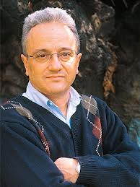


ThAnKs to
UNAM
Notes:
I would like to thank my supervisor Brent Emerson,
Godfrey Hewitt who was a great inspiration
My collaborators Nils Arrigo and Nadir Alvarez at the University of Lausanne, along with Tania Wyss and Alan Brelsford who helped with the Labwork.
My secondary supervisor Tove Jorgensen at Aarhus University and my collaborator Daniel Piñero at UNAM, Mexico.

Slide 24

AND THANKS TO YOU
A.Yanes@uea.ac.uk
AliciaMstt

Slide 25
If someone asks…

Slide 26
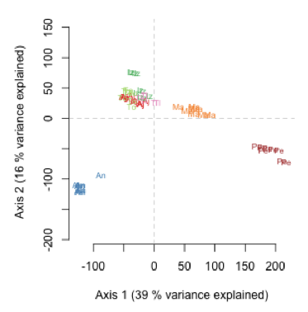
Excluding Zamorano (Za) and outgruop (Out)

